Slide 1
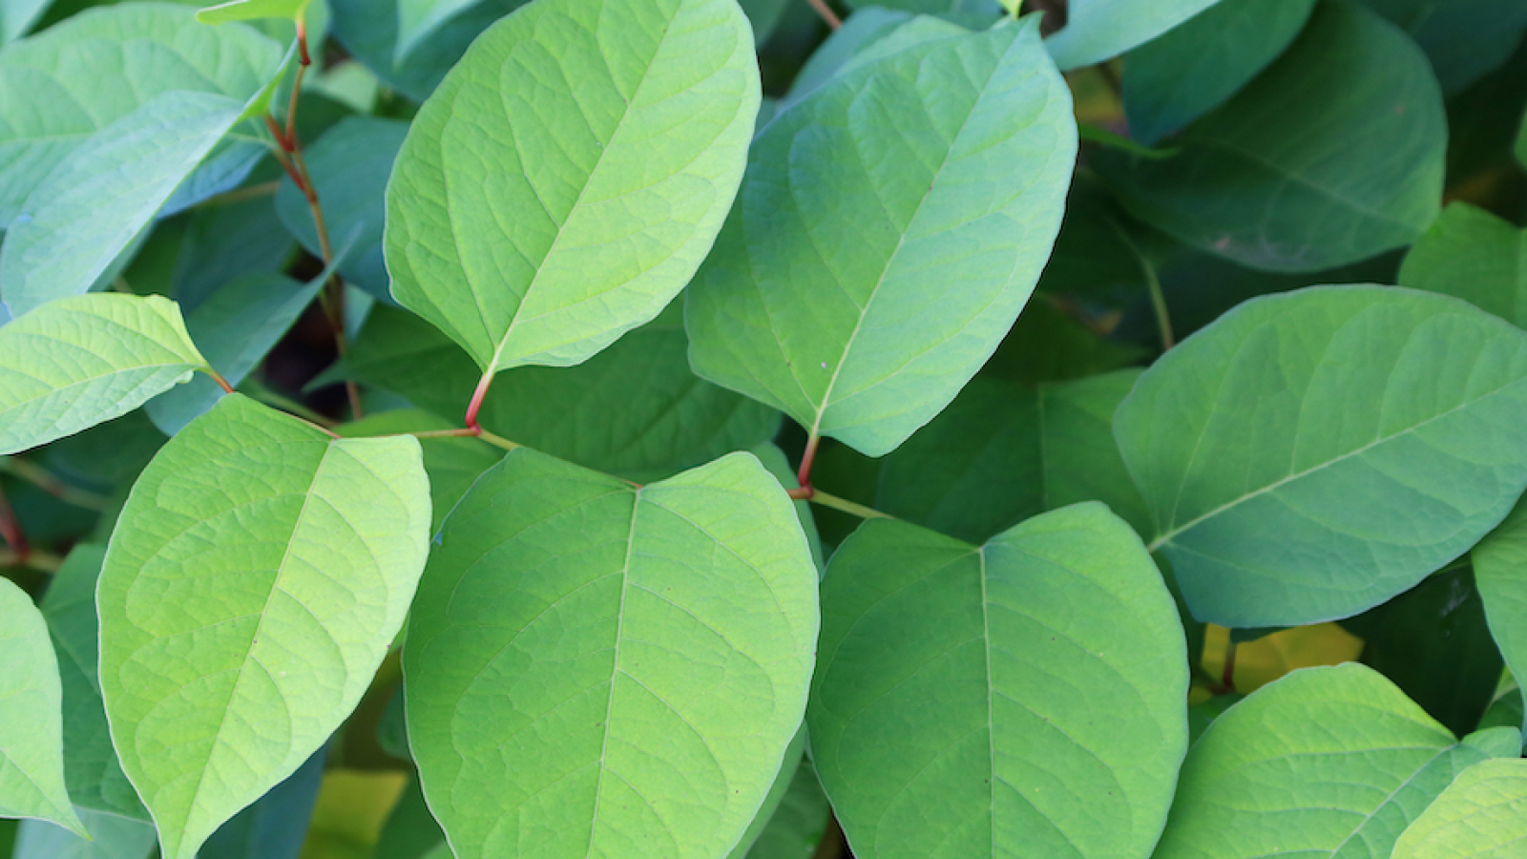
Japanese knotweed
Jaike Bijleveld
Risk-driven approach
Focus on preventing spread
Food for thought

Slide 2
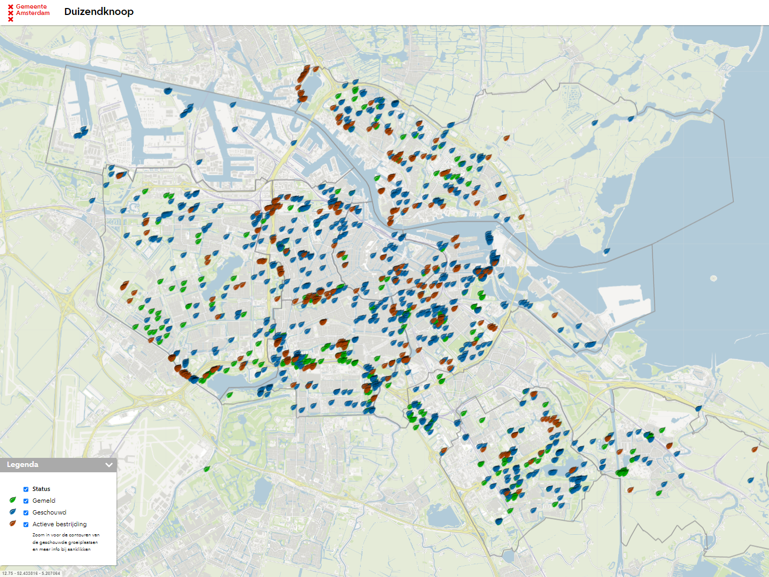
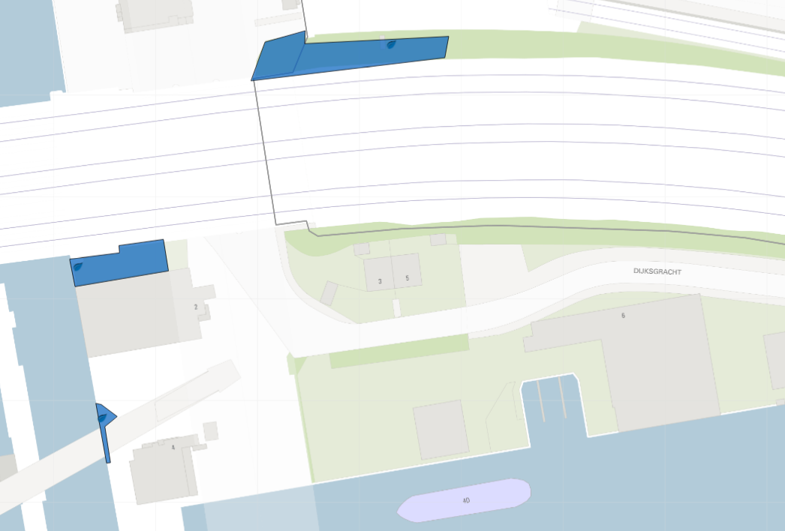
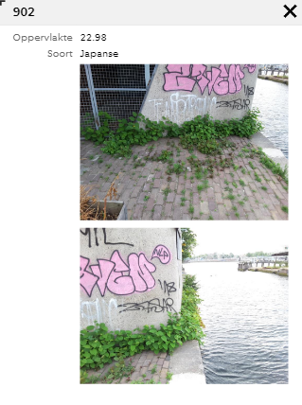
Japanese knotweed in Amsterdam

Slide 3
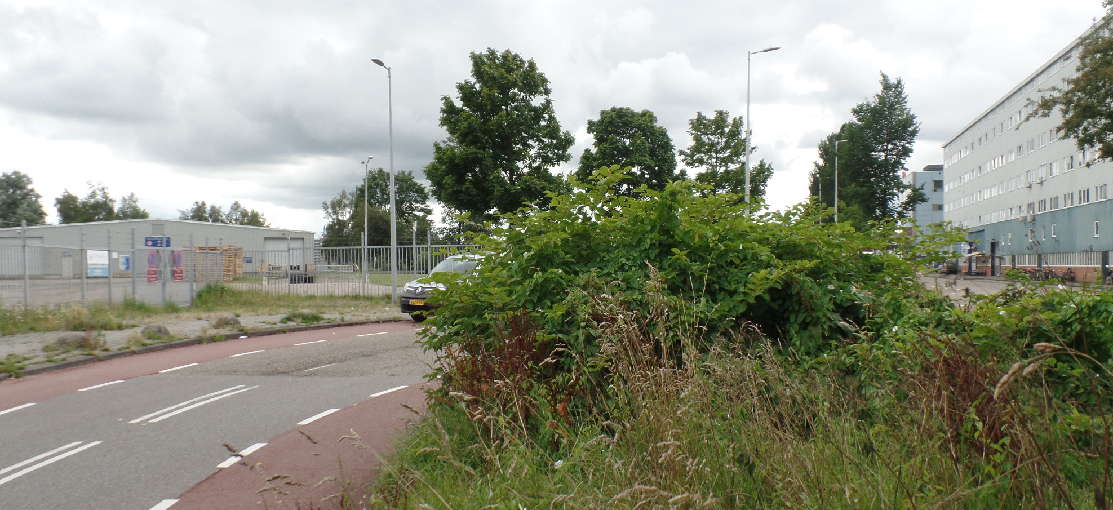
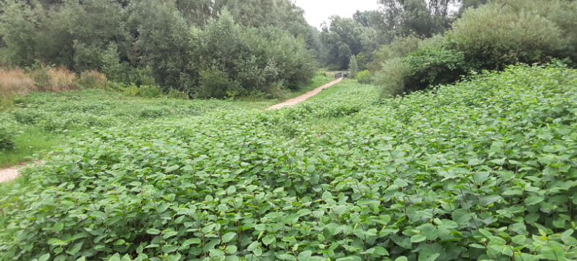
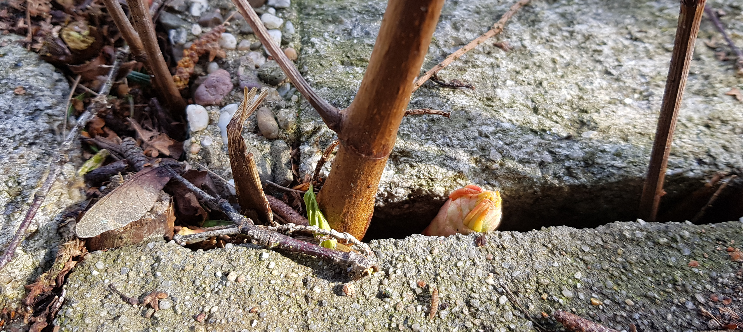
Risks in urban environment
1. Rapid spread | 2. Unsafe traffic situations
3. Damage to ecosystems | 4. Damage to constructions

Slide 4
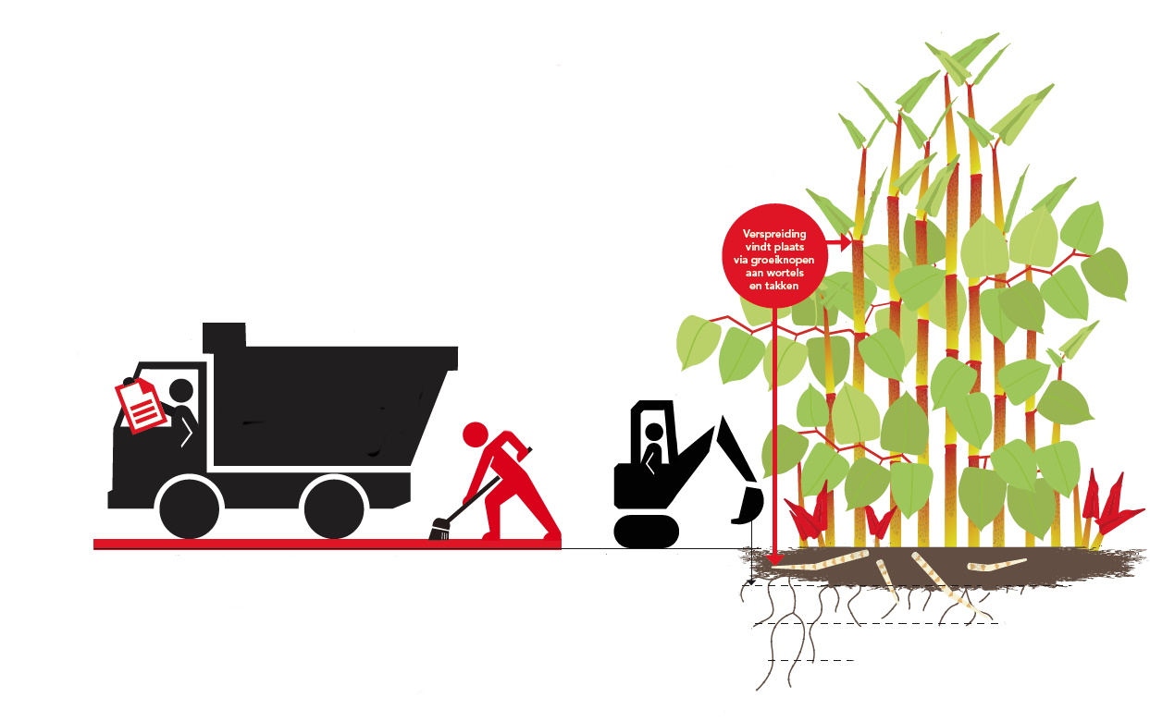
Rapid spread is mainly caused by
Transportation of soil
Maintenance

Slide 5
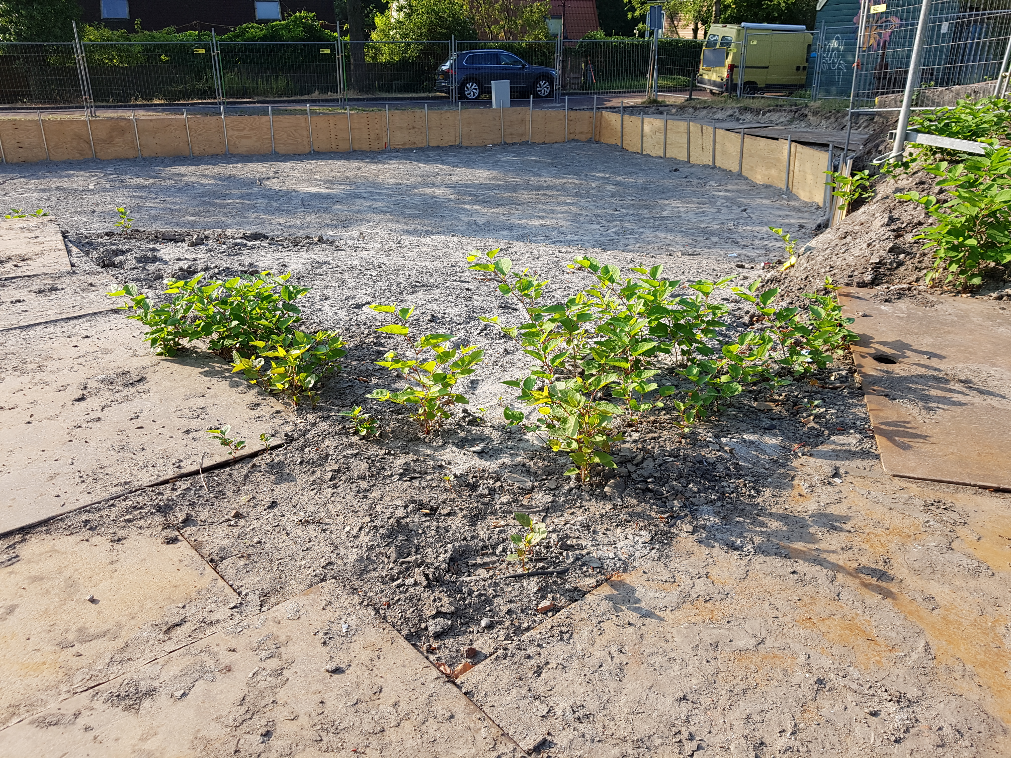
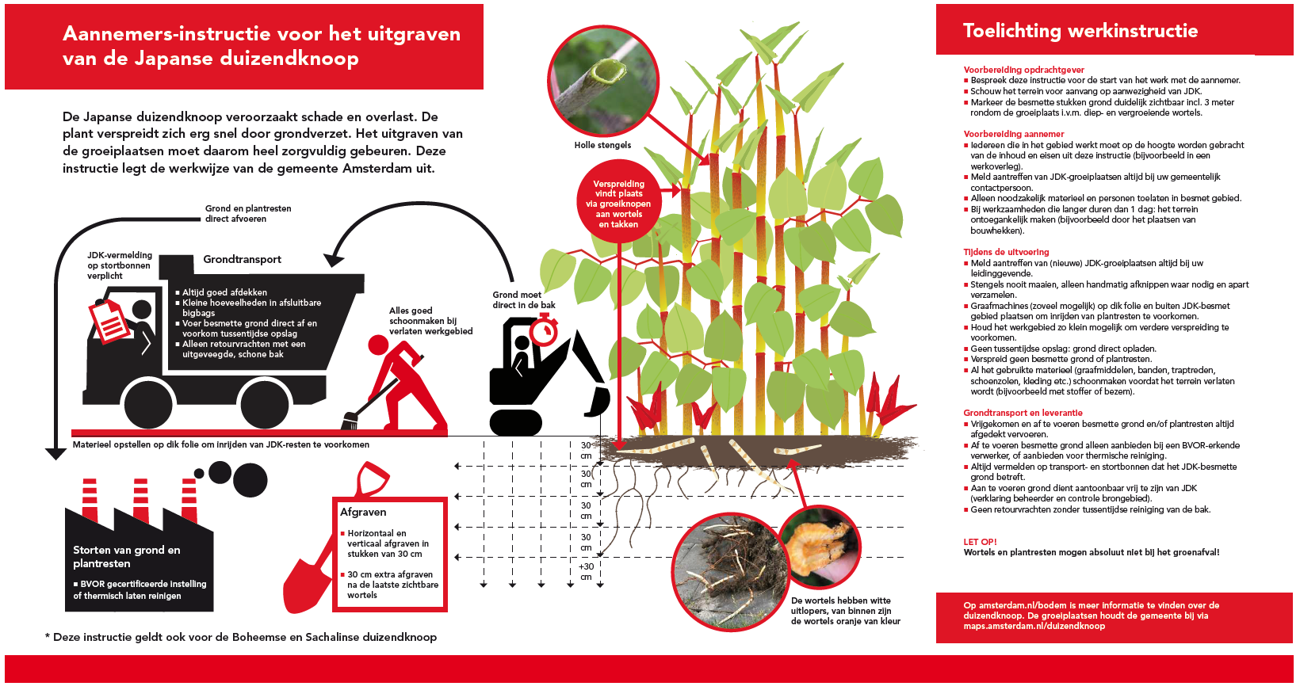
Transportation of soil – construction sites

Slide 6
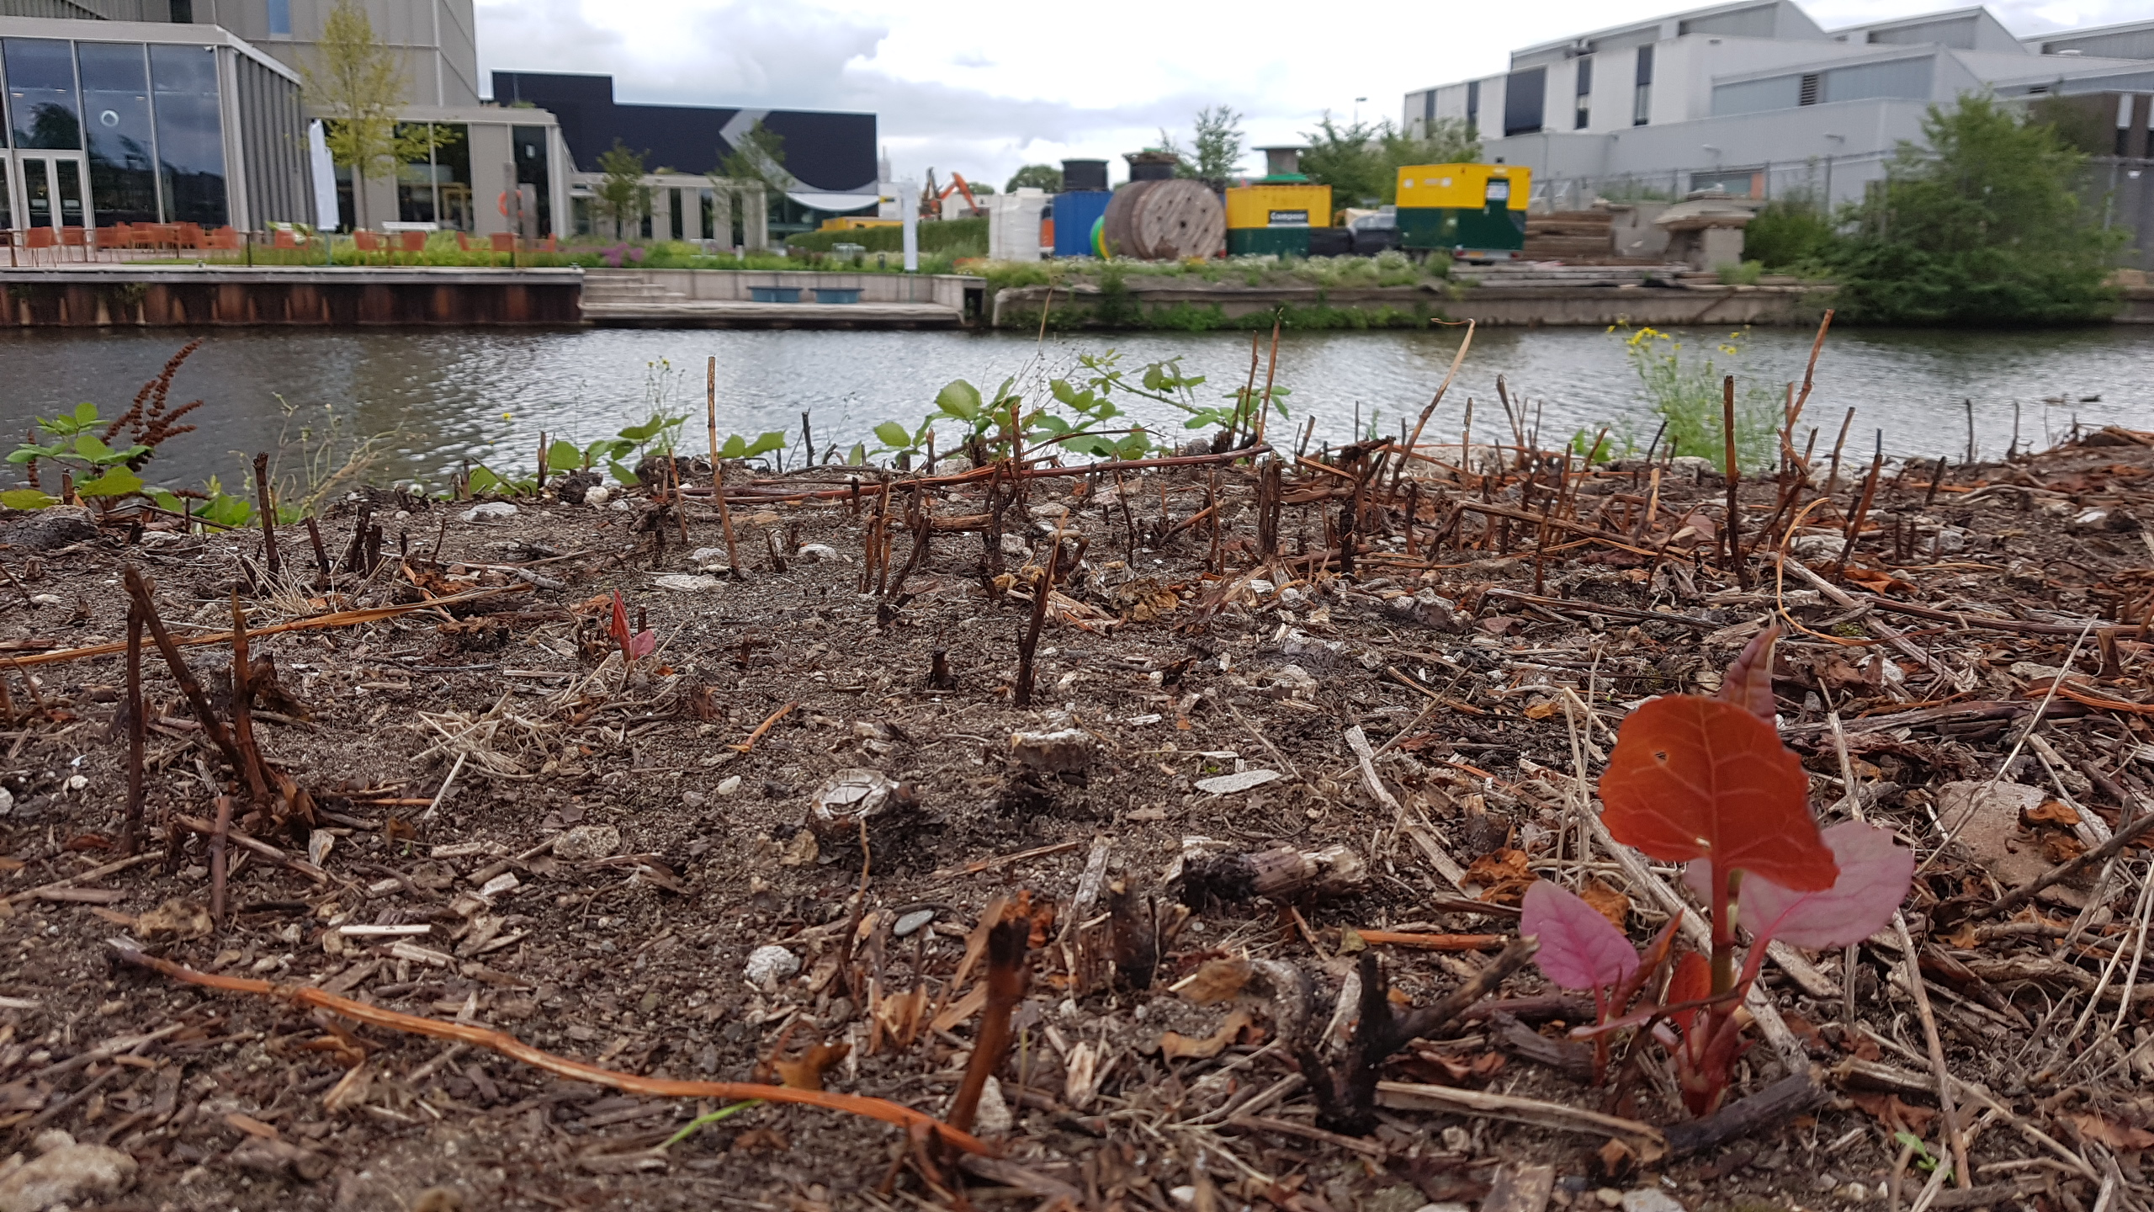
Maintenance

Slide 7
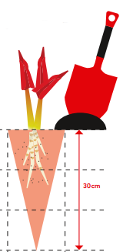
5 rules for maintenance
Work from the outside in
Remove as many roots as possible
Clean up all the leftovers of the plant lying around,
under shoes, on equipment etc.
Throw away in garbagecontainer,
never with compost
Mark the area

Slide 8
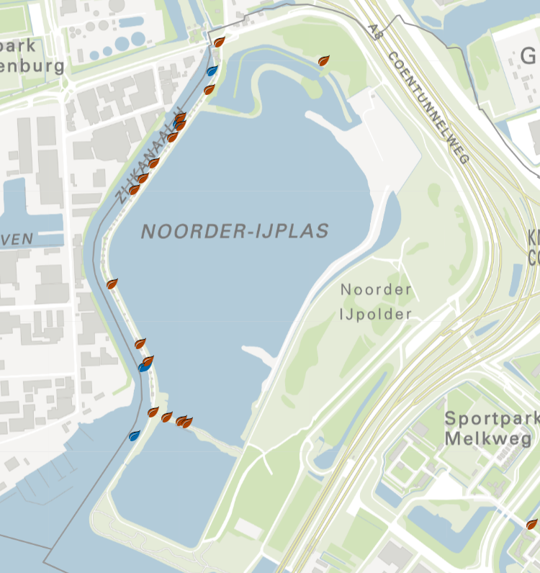
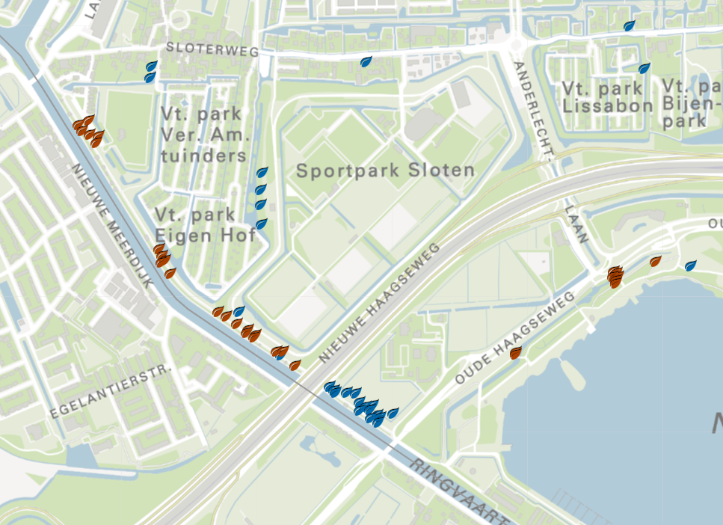
Focus on preventing spread
Education
Clean-up of spreading sites

Slide 9
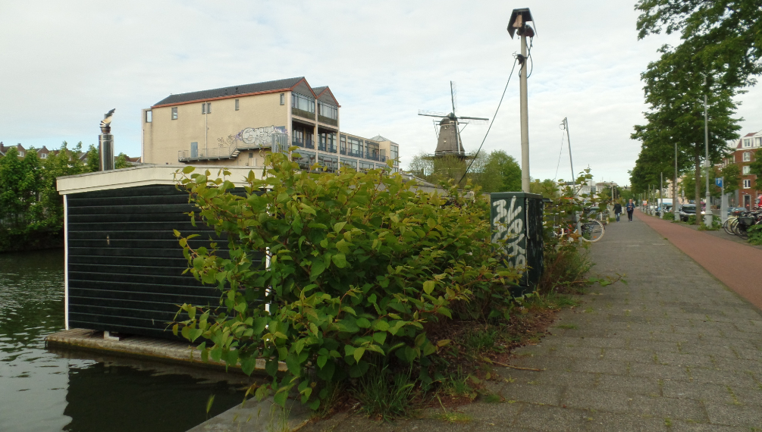
Clean up of spreading sites
3 factores that determine the approach:
Surrounding
Underground conditions
Age place of growth

Slide 10
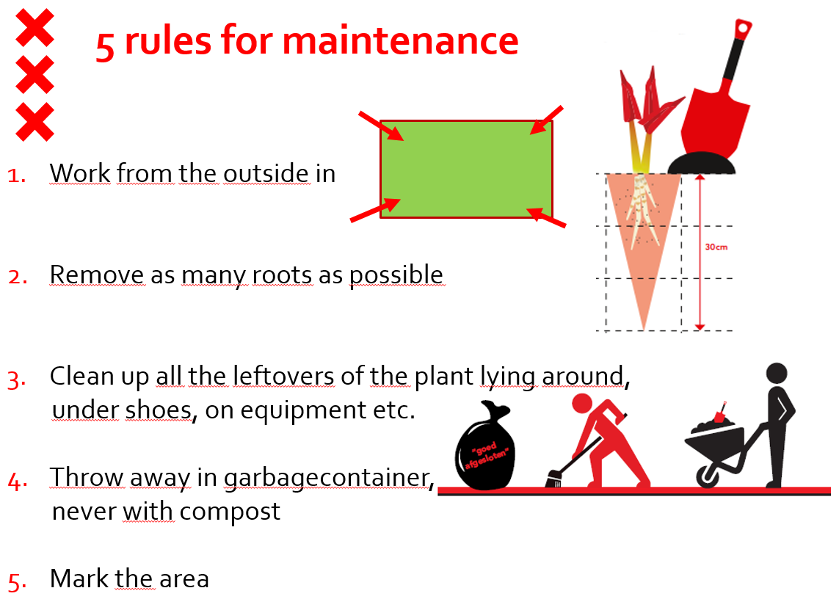
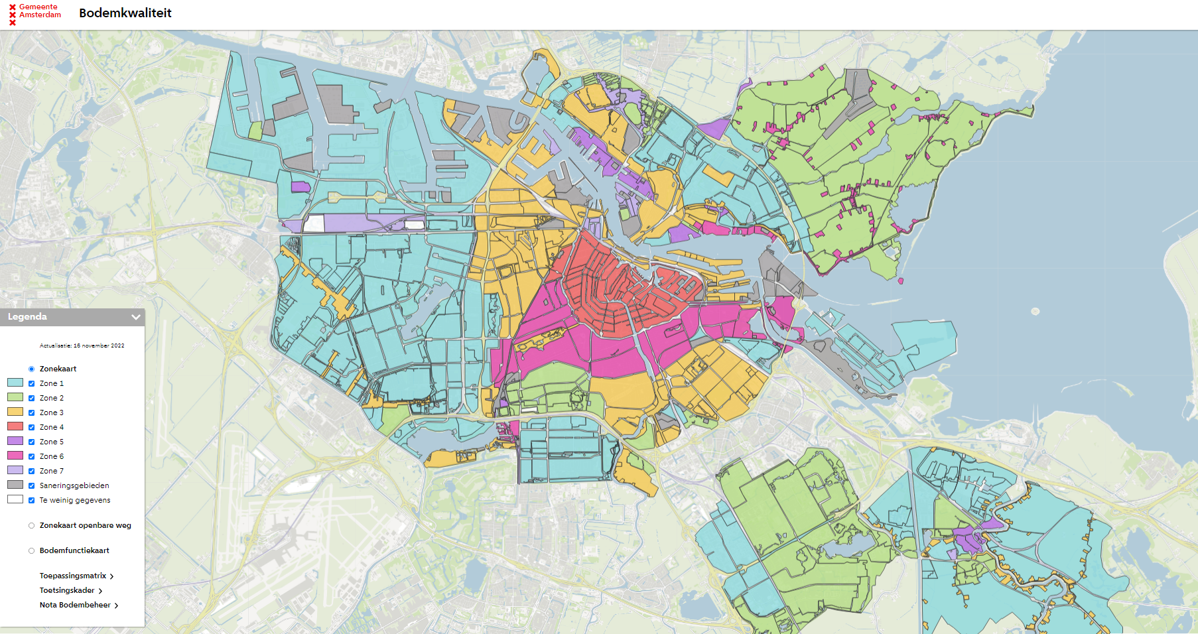
Foraging Japanese knotweed
Prevent spread
Check quality of soil

Slide 11
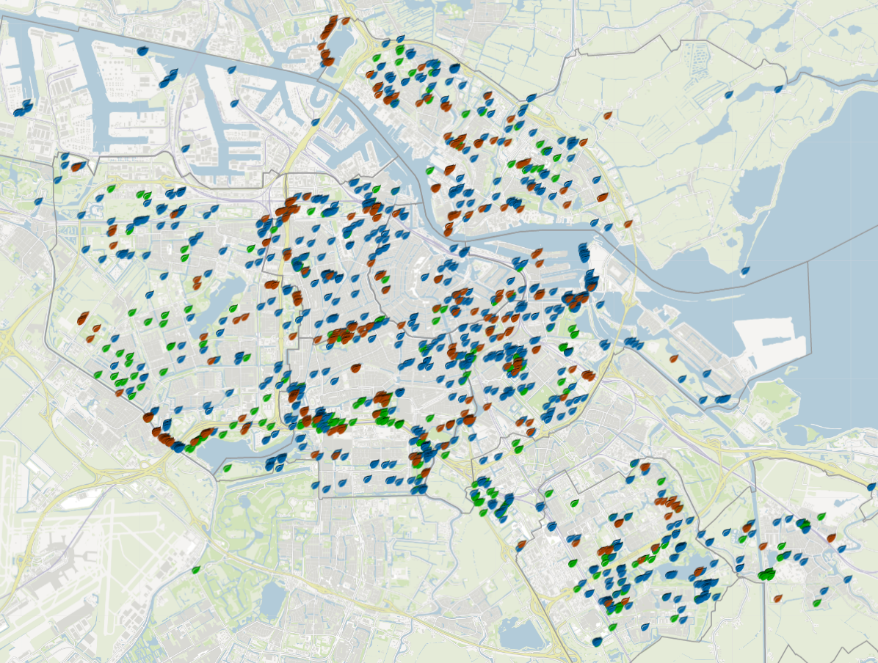
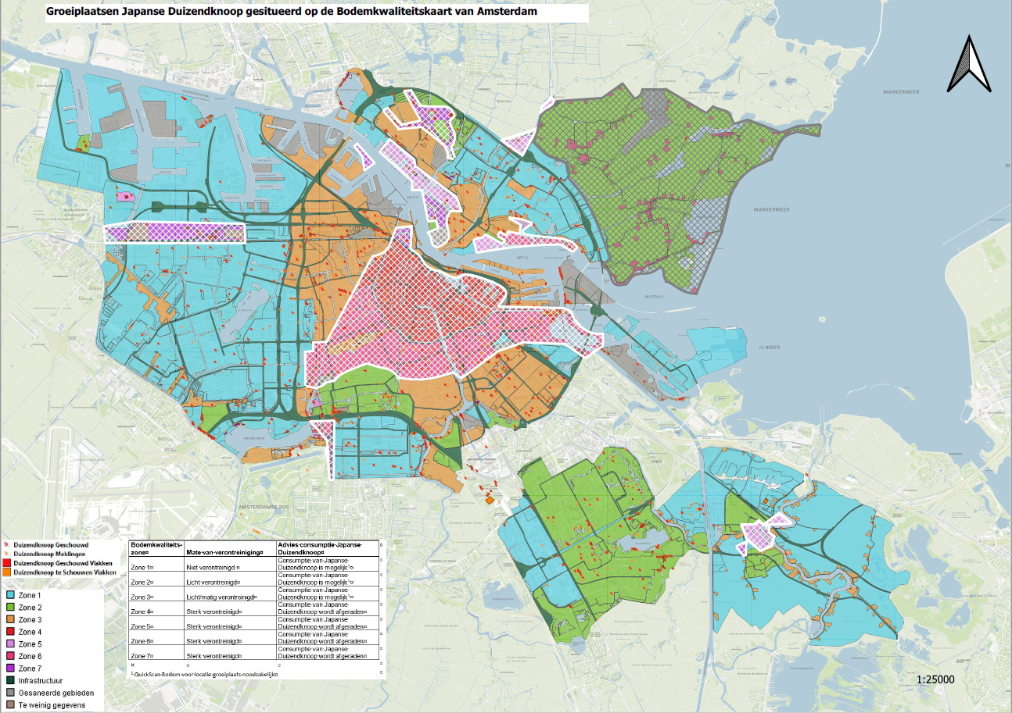
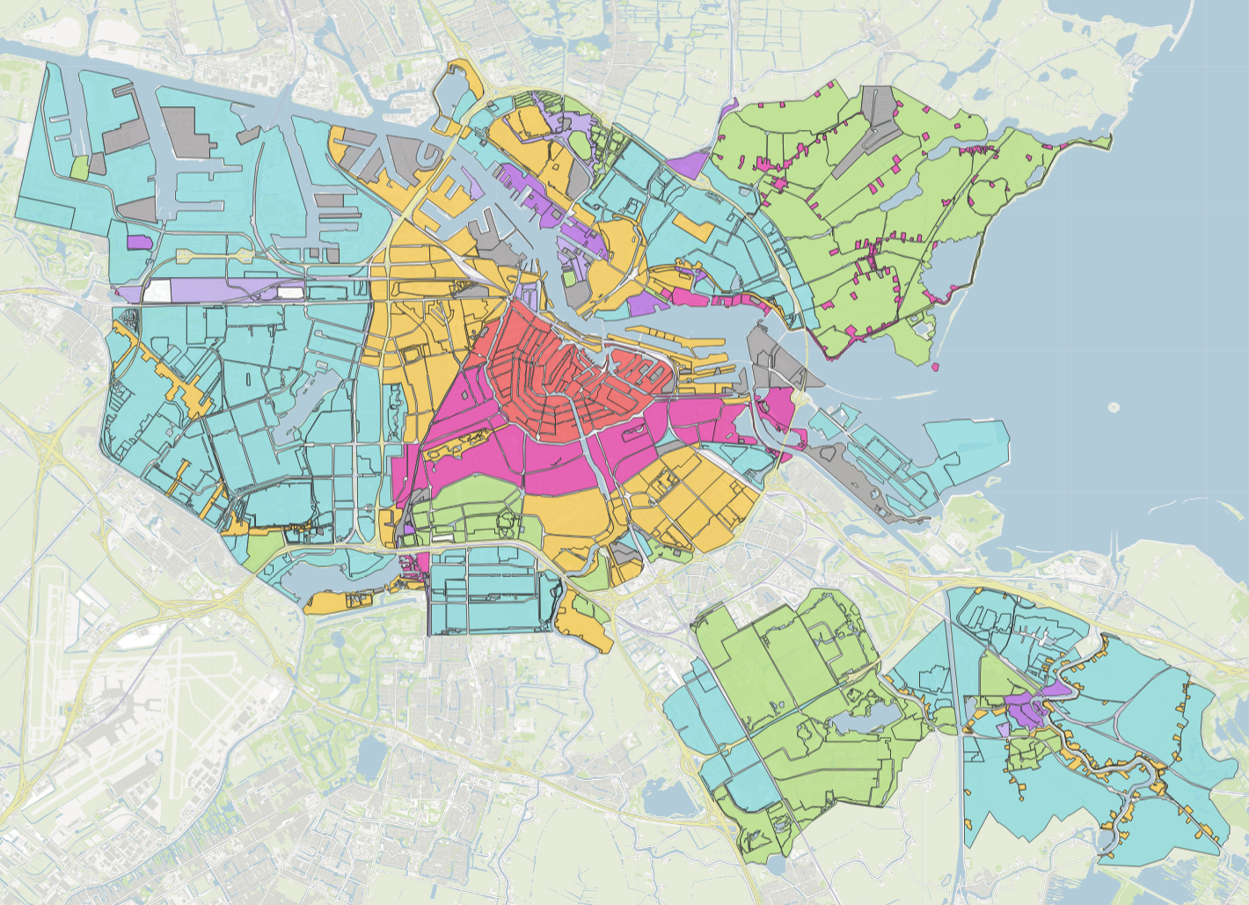
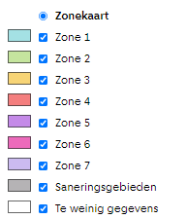
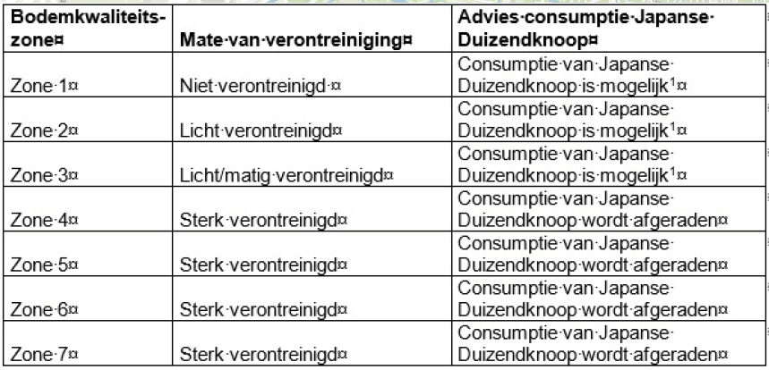

Slide 12
Want to know more?
Map with growing sites: https://maps.amsterdam.nl/duizendknoop/
Map soil quality: https://maps.amsterdam.nl/bodemkwaliteit/
Website: https://www.amsterdam.nl/wonen-leefomgeving/japanse-duizendknoop/
Follow the E-learning on our website
(recognition)
(risks & problems)
(maintenance)
(approach in projects)
(working in soil & transport)
(Knotweed in each phase of a project)

