Slide 1
Japanese knotweed What else?
Johan van Valkenburg

Slide 2
What species are we talking about
Fallopia japonica (Houtt.) Ronse Decr.
Synonyms :
Polygonum cuspidatum Sieb. & Zucc.
Reynoutria japonica Houtt.

Slide 3
How did it arrive in the Netherlands?
1848 CATALOGUE MENTION
FORMER HUIZE NIPPON

Slide 4
‘Common’ use of the name Japanese knotweed
Fallopia japonica
Fallopia sachalinensis
Fallopia x bohemica

Slide 5
How to tell them apart Fallopia japonica In NL predominantly functionally female flowers

Slide 6
How to tell them apart Fallopia sachalinensis In NL both functionally male and female plants

Slide 7
How to tell them apart Fallopia x bohemica In NL both functionally male and female plants

Slide 8
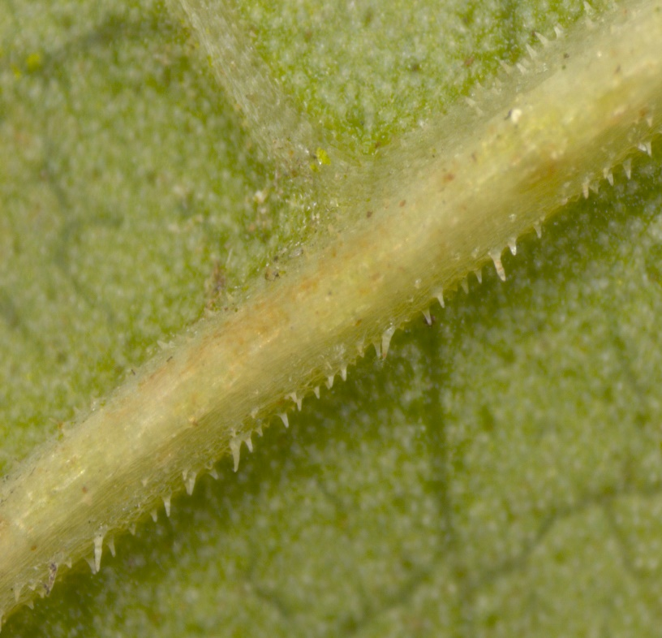
F. japonica F. x bohemica F. sachalinensis

Slide 9
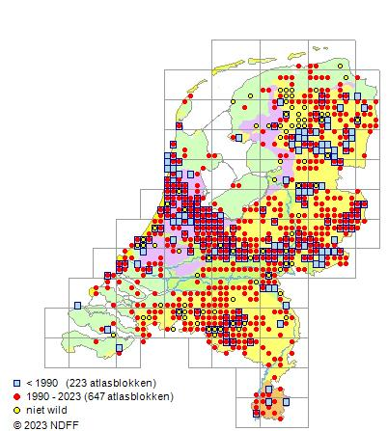
F. japonica F. x bohemica F. sachalinensis

Slide 10
What about the hybrid F. x bohemica
Described from the Czech Republic hence the name ‘bohemica’ (as Reynoutria x bohemica in 1983)
Actually the hybrid has arisen multiple times. Tetra-, hexa- and octoploid
Genetically rather heterogenic
More robust than F. japonica
For a long time ‘overlooked’
Probably the predominant species in NL

Slide 11
Is there a problem?

Slide 12
Is there a problem?

Slide 13
Is there a problem?

Slide 14
The 3 Fallopia are regulated since 1-1-2022

Slide 15
Another regulated knotweed EU regulation 1143/2014
Himalayan knotweed
Persicaria wallichii
Synonyms
Koenigia polystachya
Aconogonon polystachyum
Reynoutria polystachya

Slide 16
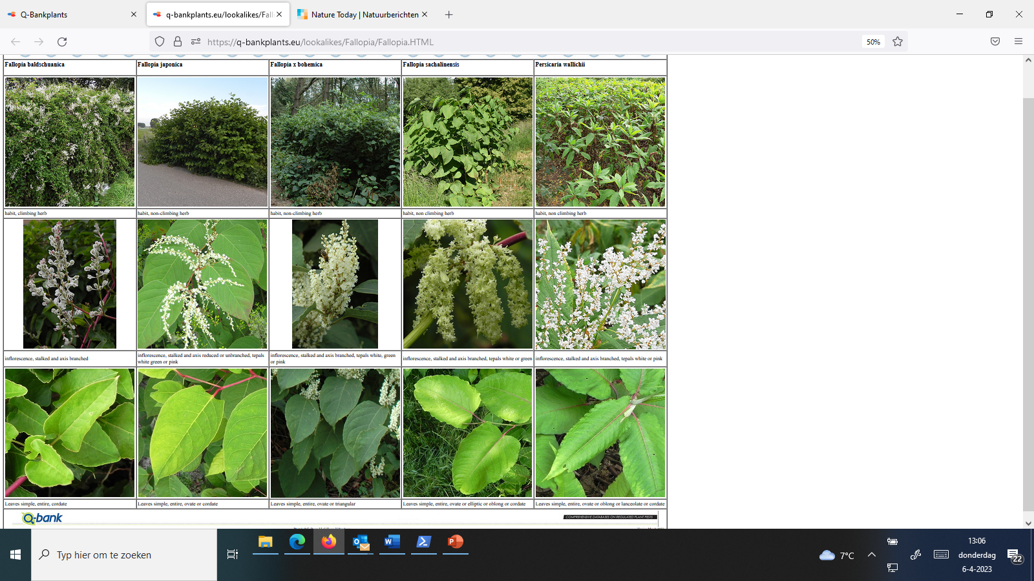

Slide 17
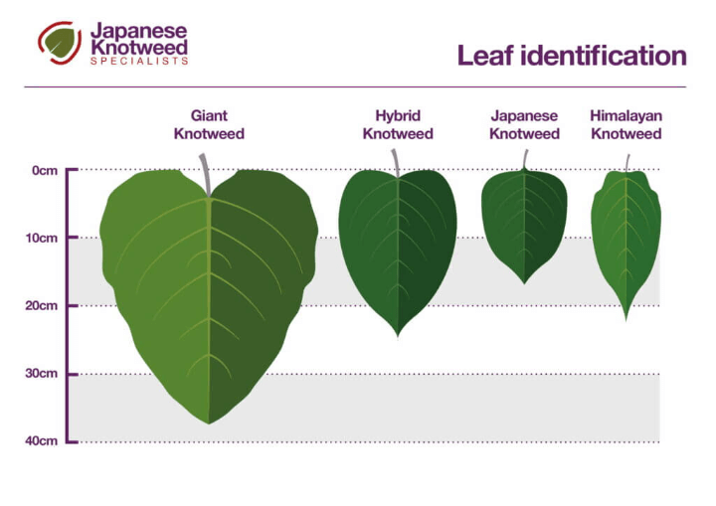

Slide 18
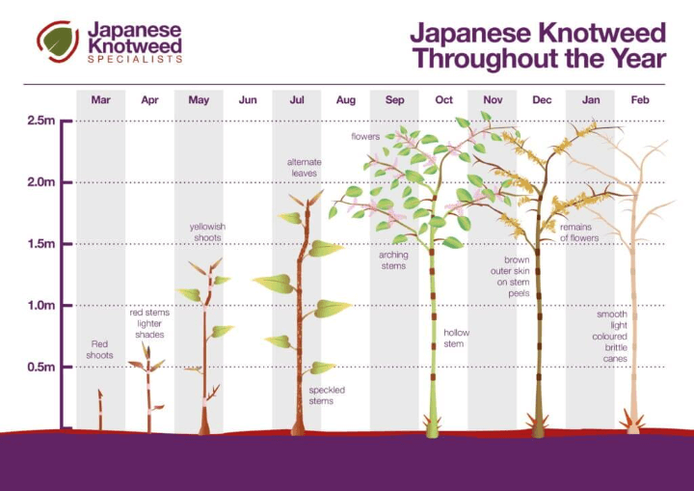

Slide 19
What makes a plant an “invasive exotic”
Not originally present in a given area
Not behaving in the way we would like it to behave
A threat to biodiversity
A threat to crop production ( a “weed”)
From a policy perspective (NL government)
Not originally native to Europe
Could not arrive solely by natural means
Before it can be regulated a formal Risk Assessment is required

Slide 20
Other regulated/problematic plants
REGULATED
PROBLEMATIC

Slide 21
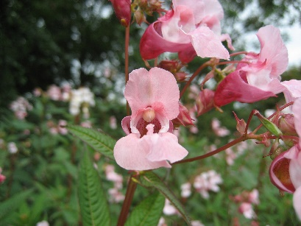
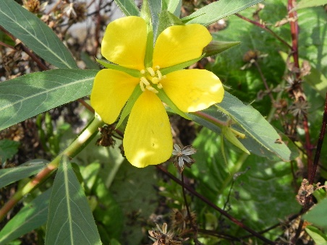
EU regulation 1143/2014, Union list
26 TERRESTRIAL PLANTS
14 AQUATIC PLANTS

Slide 22
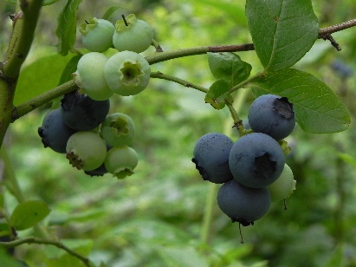
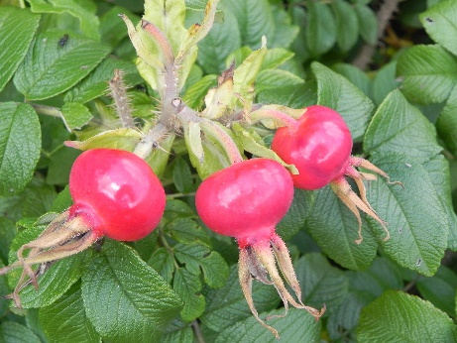
Non-listed problematic species
VACCINIUM CORYMBOSUM
ROSA RUGOSA

Slide 23
What do we do (NVWA/NIVIP)
Provide ID tools for official inspections and surveyors
Support identification of interceptions and citizen science records
Management advice for emerging invasive plants
Perform risk assessments

Slide 24
ID Tools

Slide 25
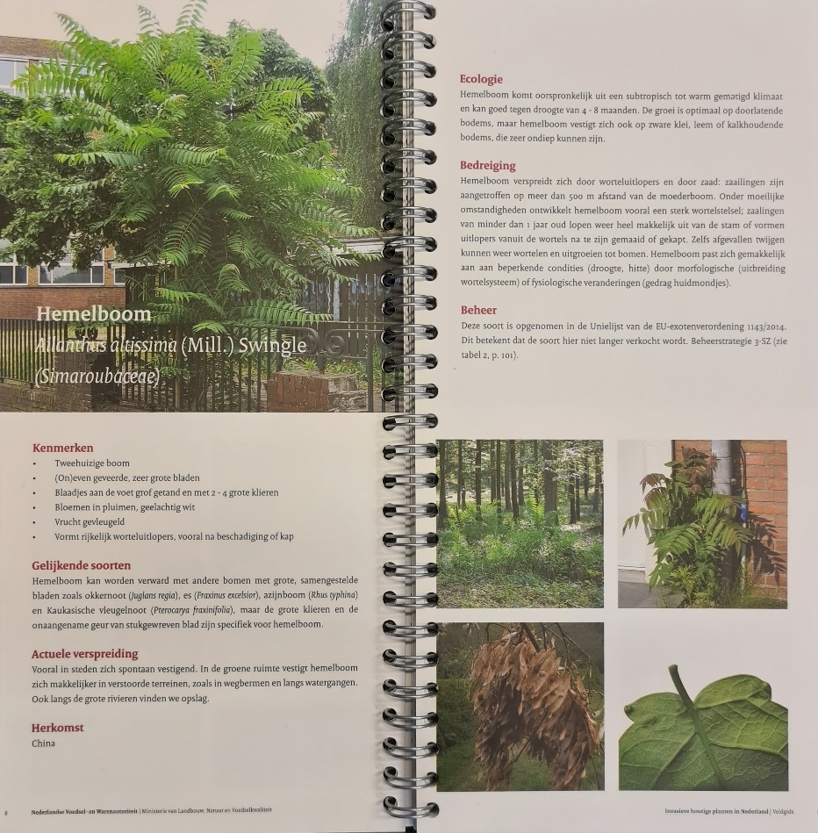
Field guide woody invasive exotic plants

Slide 26
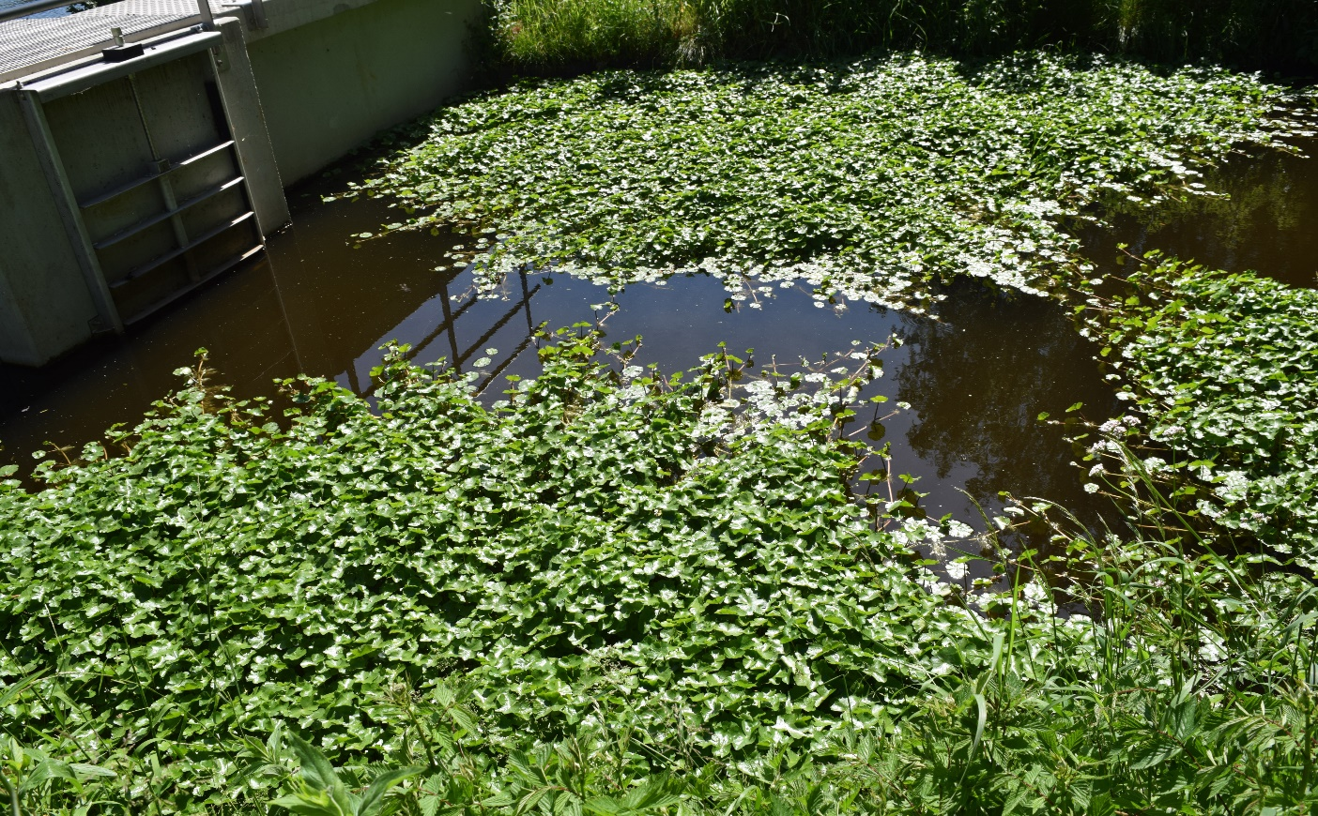
NOT SO NICE ANYMORE
STILL LOOKS NICE AND GREEN

