Slide 1
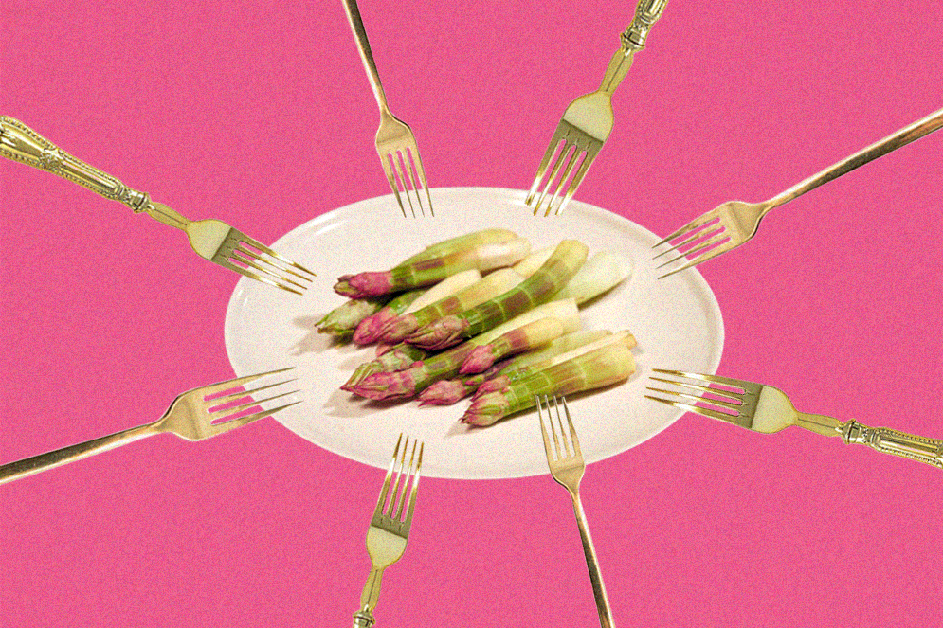
If you can’t beat it… eat it!
Pauline Wiersema

Slide 3
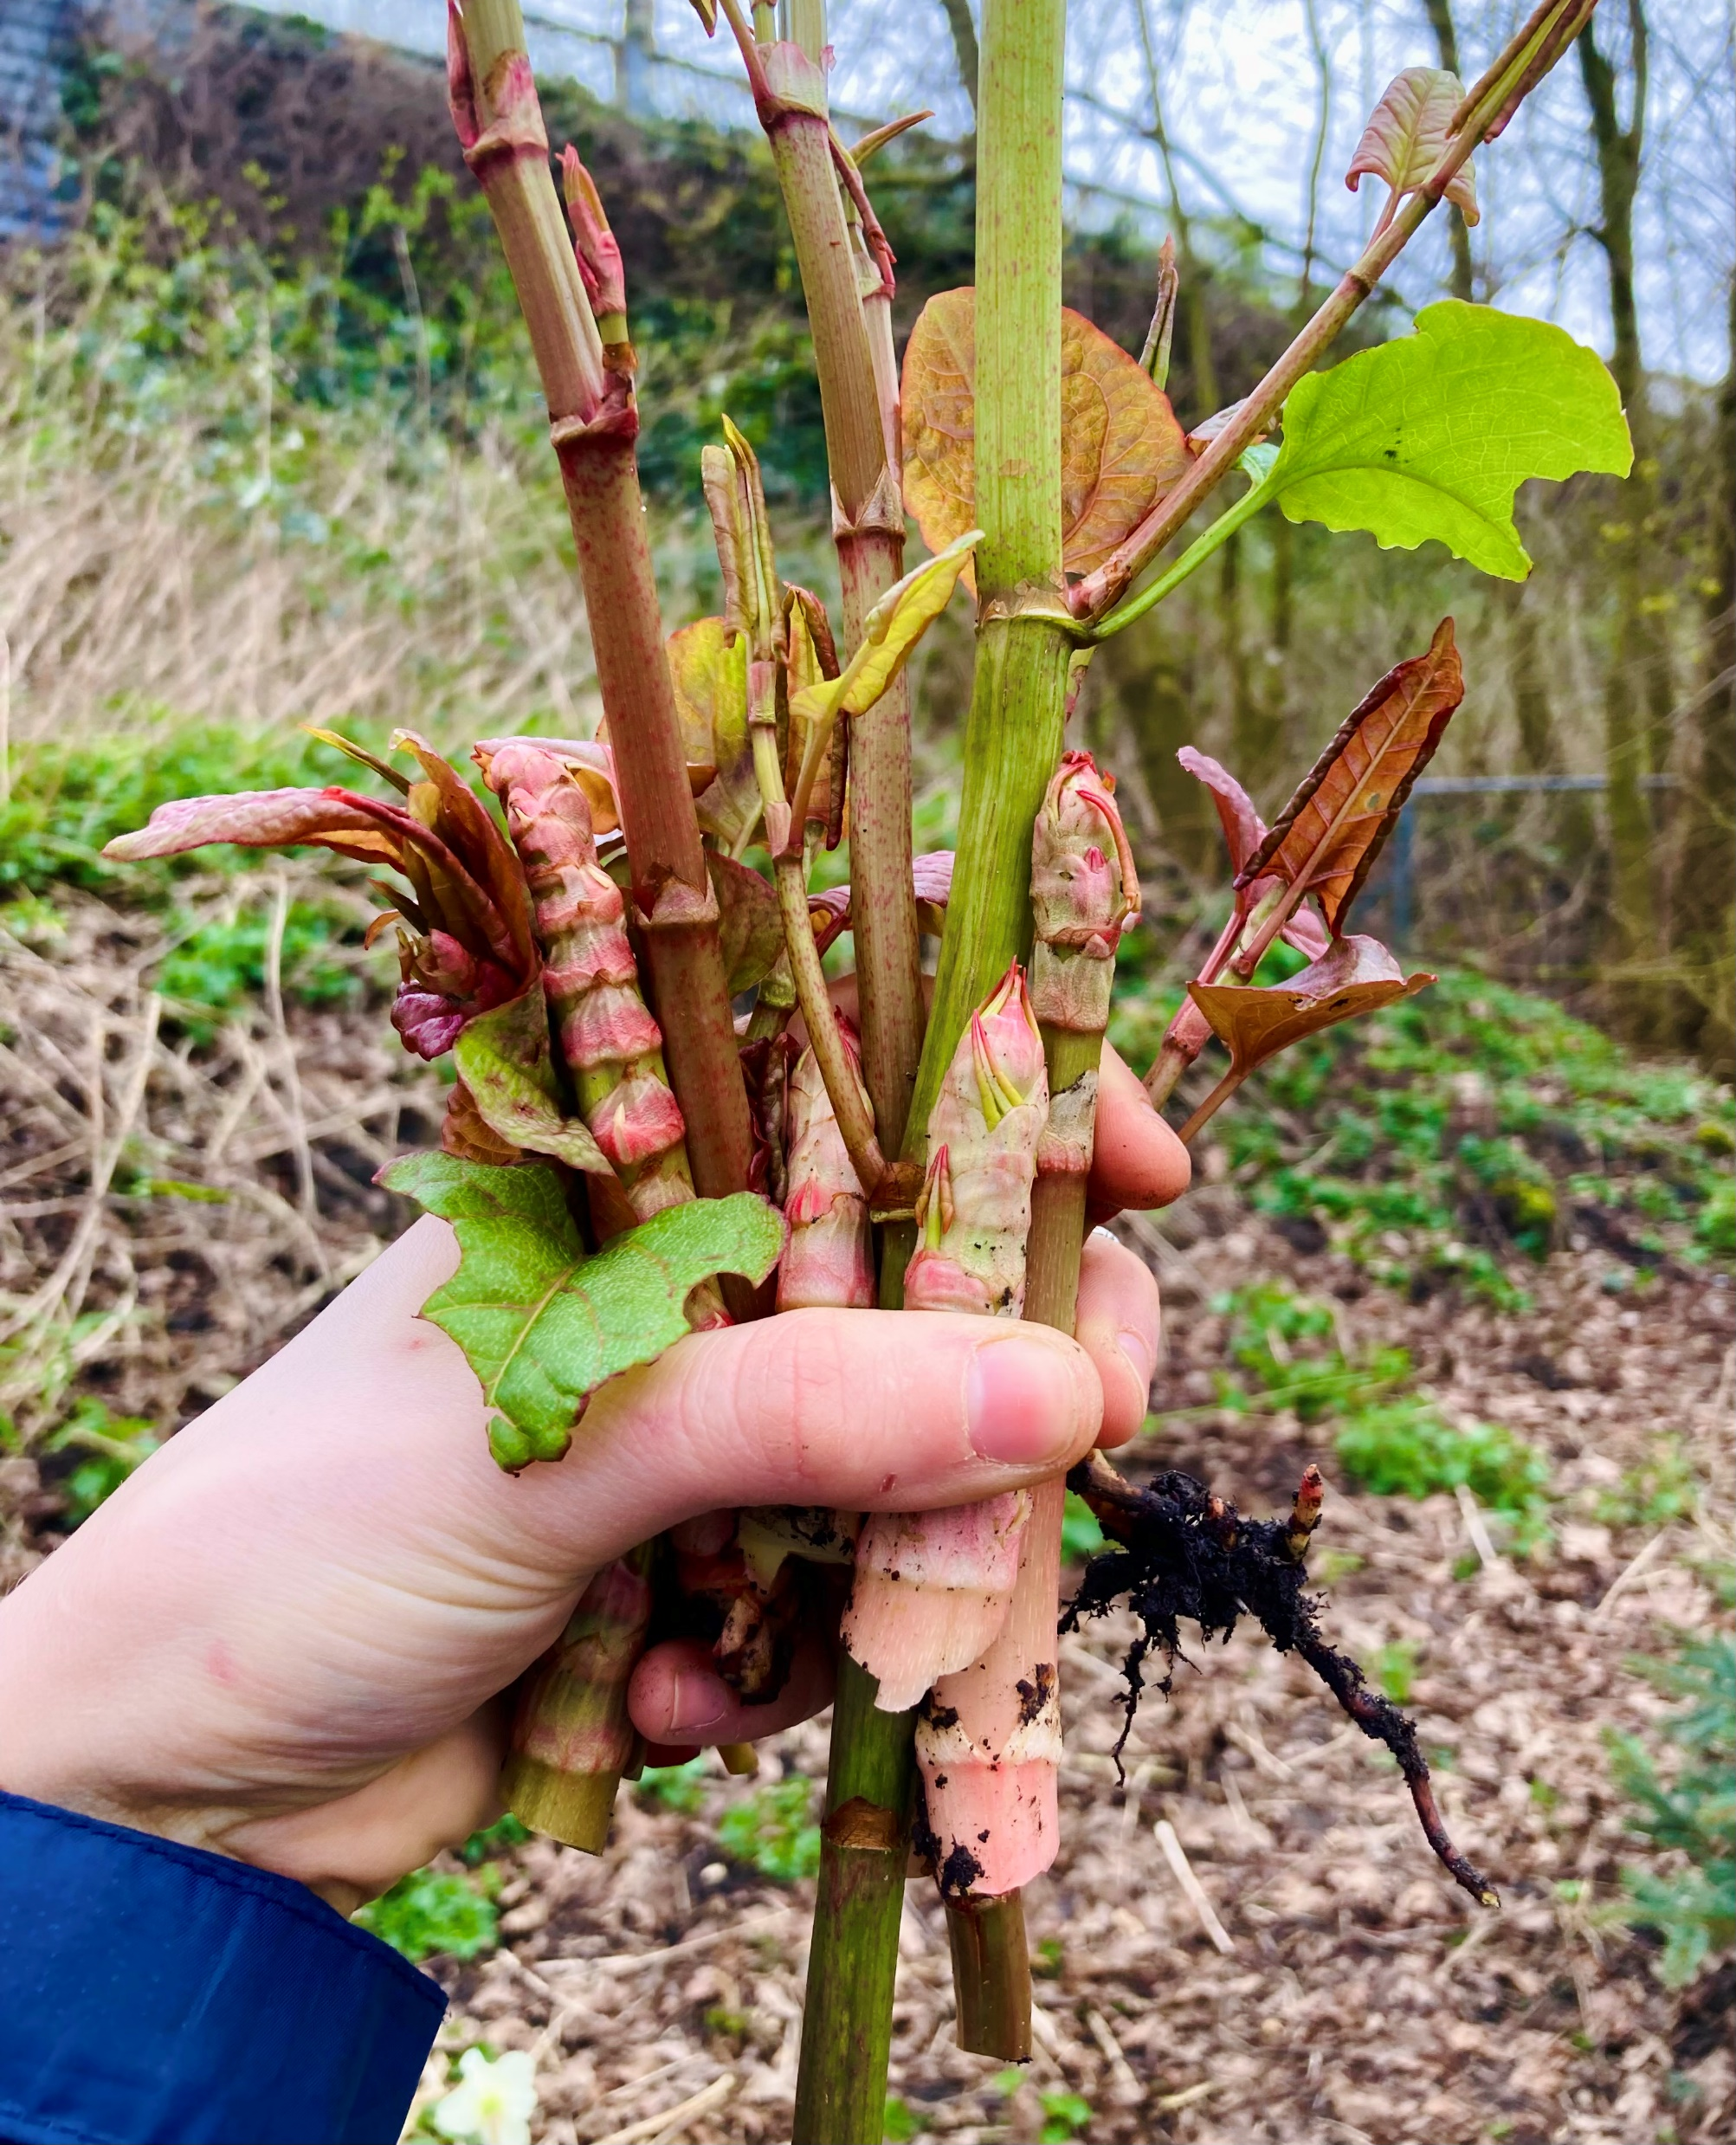
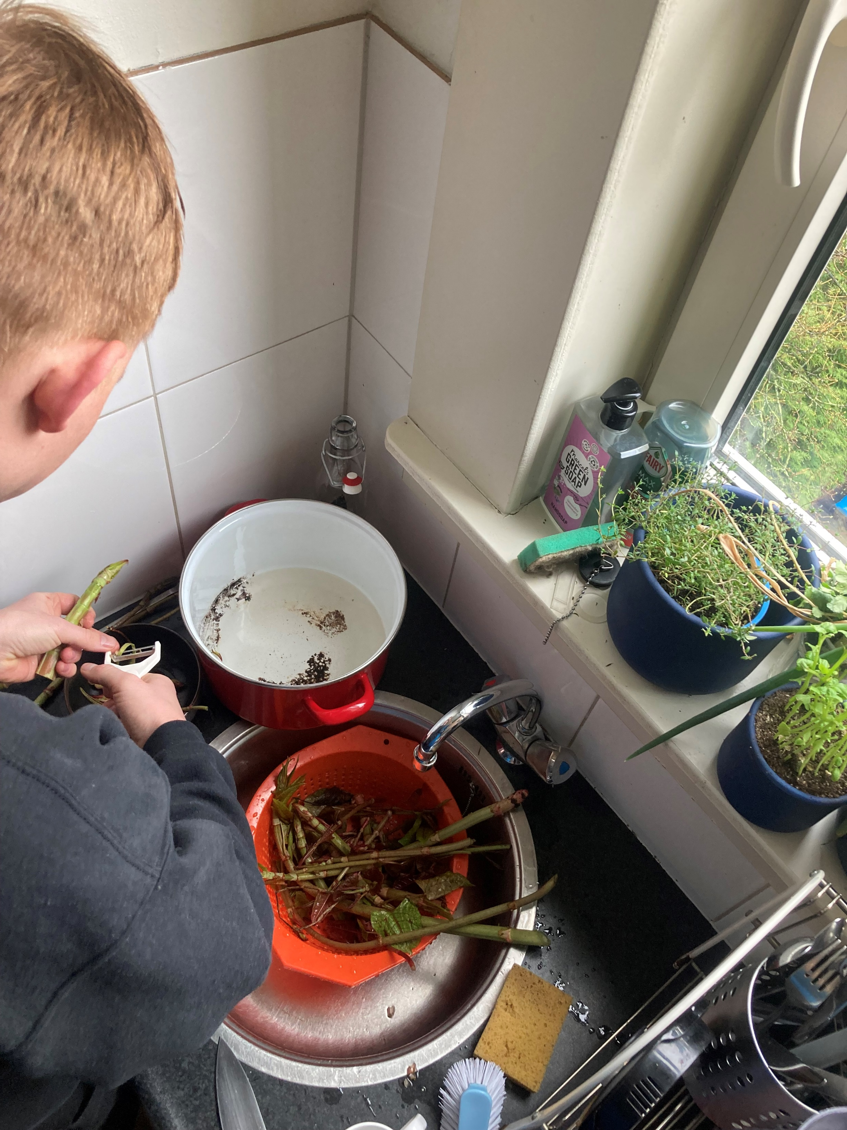
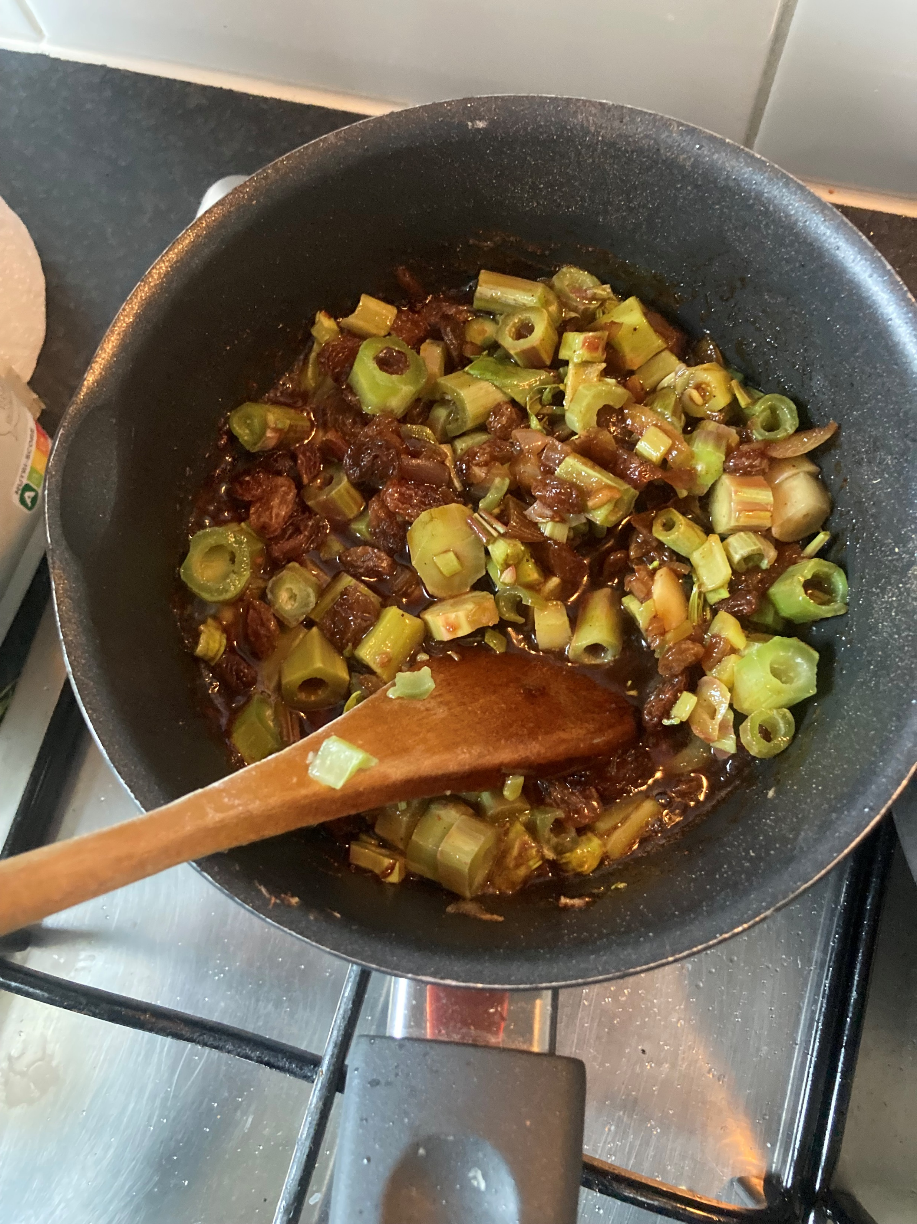

Slide 4
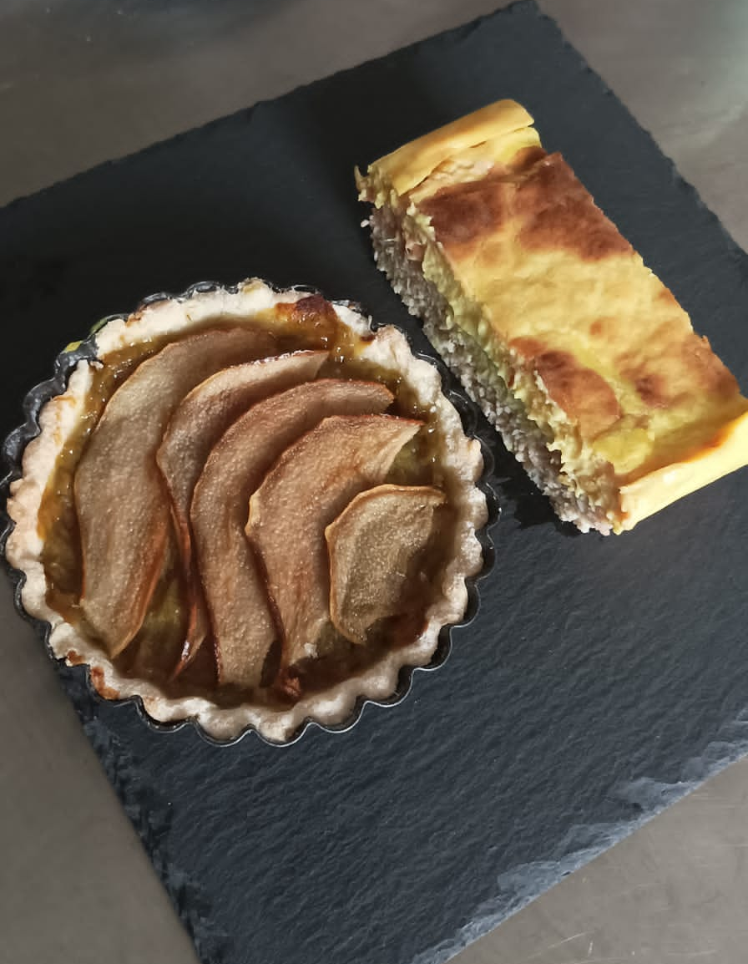
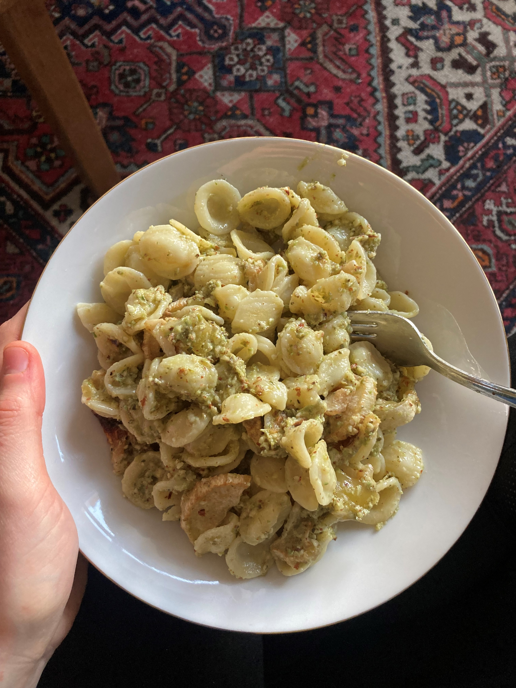
+ three incredible vegan chefs!

Slide 5
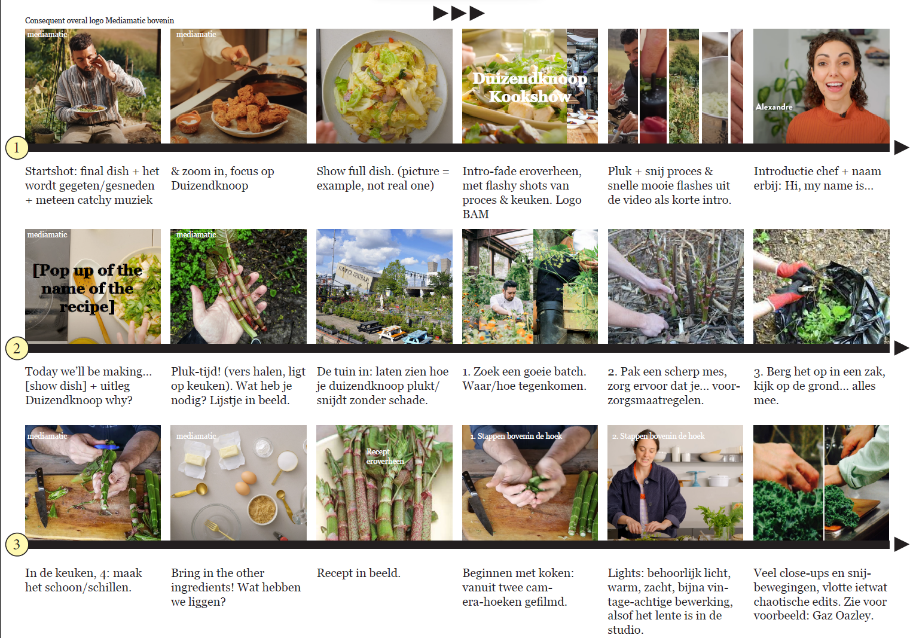
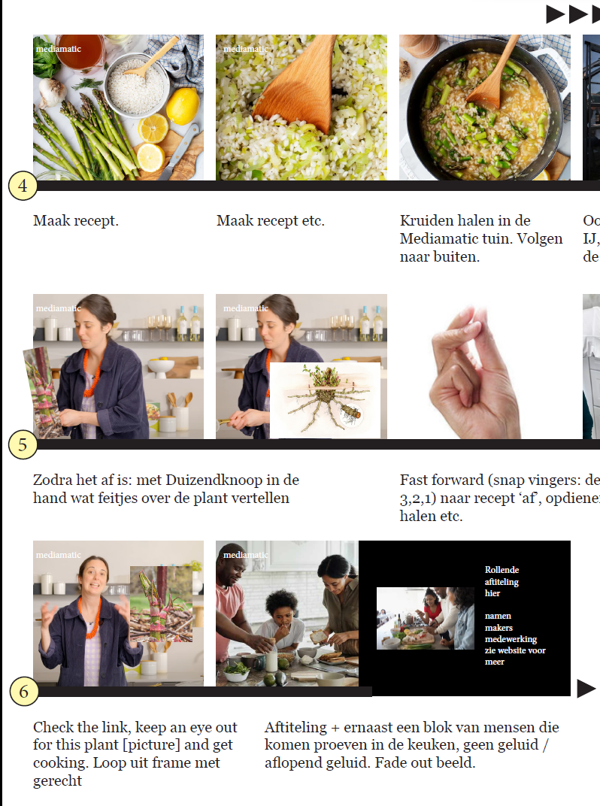
Step by step…

Slide 6
To be continued on April 17…

Slide 7
End goal: EVERYONE EATING KNOTWEED!*
*because it’s delicious & simple & cheap

